Slide 1


Refining Your AI Model in MATLAB

Slide 2

Final Project – Evaluating and Refining Your Model
In the previous lesson, we learned how to import, extract, sort, and choose a machine learning model based on the data chosen for the final project to train an AI model.
Now, you will be evaluating the model you created and refining it for your final project!

Slide 3
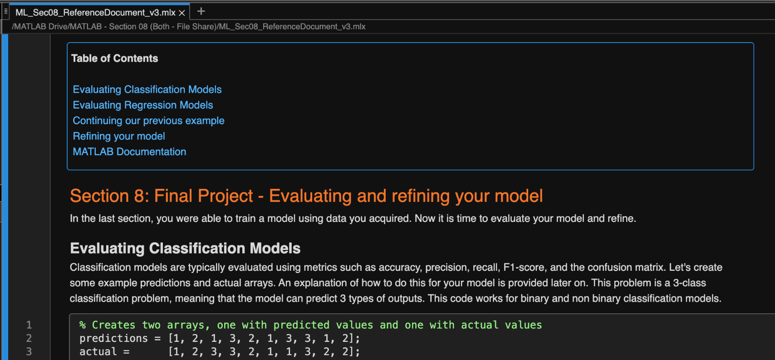
Final Project – Evaluating and Refining Your Model – Section 08 Reference Document
Please copy over the files for Section 08 from the MATLAB Drive
The MATLAB files for this section can be found at this link.
Notes:
The URL on this slide is for the student version of the files, please see the teacher guide for the teacher version of the files You can also find the teacher and student links on the master document with all the youtube video and matlab drive links for every section on it

Slide 4

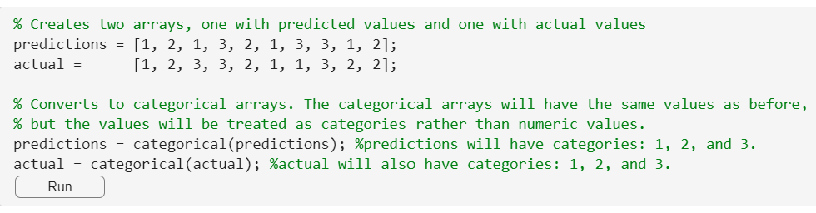
Evaluating Your Model
Classification Models
In the previous section, you successfully trained a classification model using the data you collected. Now, it's time to evaluate its performance and make any necessary refinements.
Evaluating Classification Models
To thoroughly assess the effectiveness of your classification model, we utilize several key metrics: accuracy, precision, recall, F1-score, and the confusion matrix. These metrics provide a comprehensive understanding of how well the model is performing in predicting the correct classes.
This problem involves a 3-class classification, meaning the model can predict one of three possible outcomes. The evaluation process detailed below is applicable to both binary and multi-class classification models.
Array creation to compare predictions vs actual values. This is to use how effective our model is.
Function used to convert to categorical labels.

Slide 5
Evaluating Your Model
Confusion Matrix
Let's use a confusion matrix to compare the variables predictions and actual.
A confusion matrix is a table that helps us see where the model is getting things right and where it's getting things wrong. It shows the actual outcomes versus the predicted outcomes.
Recall the confusion matrix function you learned in lesson 5
Components of a confusion matrix
Each Row represents the instances in an actual class
Each column represents the instances in a predicted class
Diagonal elements represent the number of correct predictions for each class
Off-diagonal elements represent the number of incorrect predictions
Function used to create a confusion matrix based on actual and prediction values.

Slide 6
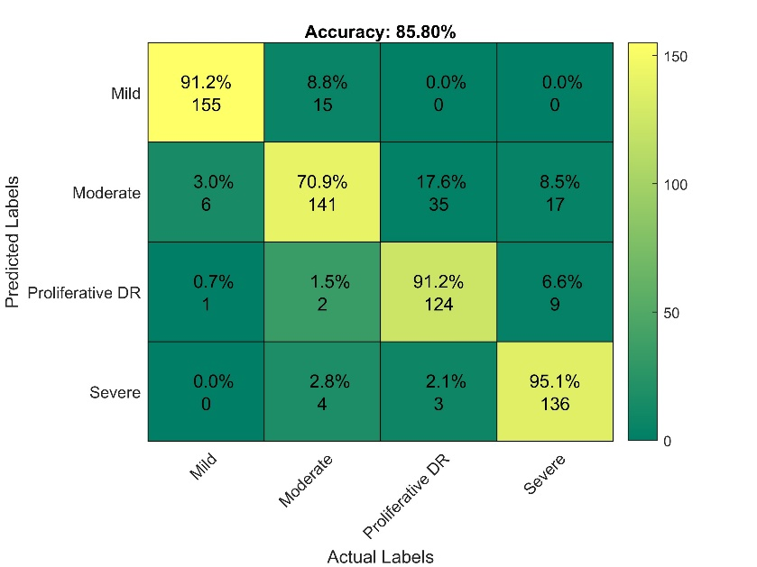
Evaluating Your Model
Confusion Matrix
Metrics from the Confusion matrix
True Positives (TP): the diagonal elements, representing correctly predicted instances for each class
False Positives (FP): The sum of each column excluding the diagonal element
False Negatives (FN): The sum of each row excluding the diagonal element
True Negatives (TN): All the other elements that are not part of the row or column of the current class
Figure shows what a confusion matrix looks like.

Slide 7

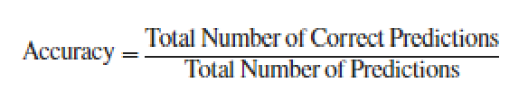
Evaluating Your Model
Accuracy
What it means: Accuracy tells us how often the model is correct. It's asking, "Out of all the predictions the model made, how many times did it get the correct answer?“
Example: if your model makes 100 predictions and gets 90 of them right, the accuracy is 90%
Accuracy can be calculated by dividing the number of correct predictions (true positives) by the total number of predictions.
Normalized values from the confusion matrix are used to calculate accuracy, precision, and other metrics

Slide 8

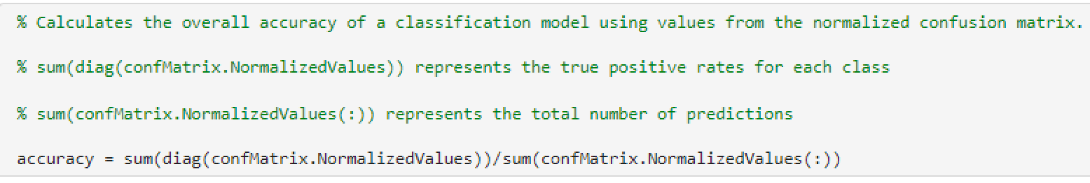

Evaluating Your Model
Accuracy
The code block shows how to implement the formula of the previous slide to calculate accuracy!
Which should take more precedence in your model? The speed it is able to process data or how accurately it sorts the data?

Slide 9

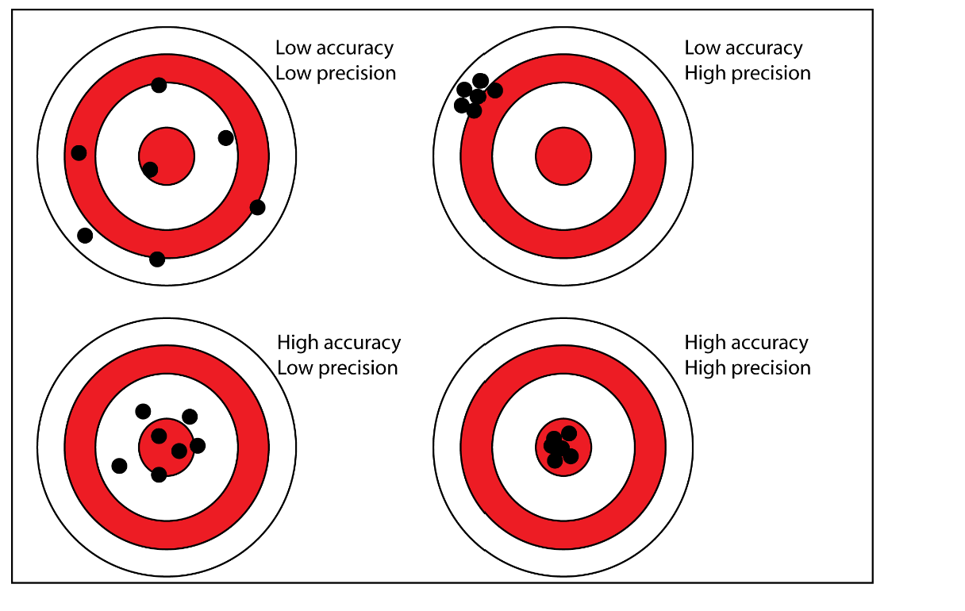
Evaluating Your Model
Precision
Precision tells us how many of the predicted positive results were correct. It's like asking, "Of all the emails the model said were spam, how many really were spam?"
This figure helps show the difference between high and low levels of accuracy and precision.

Slide 10
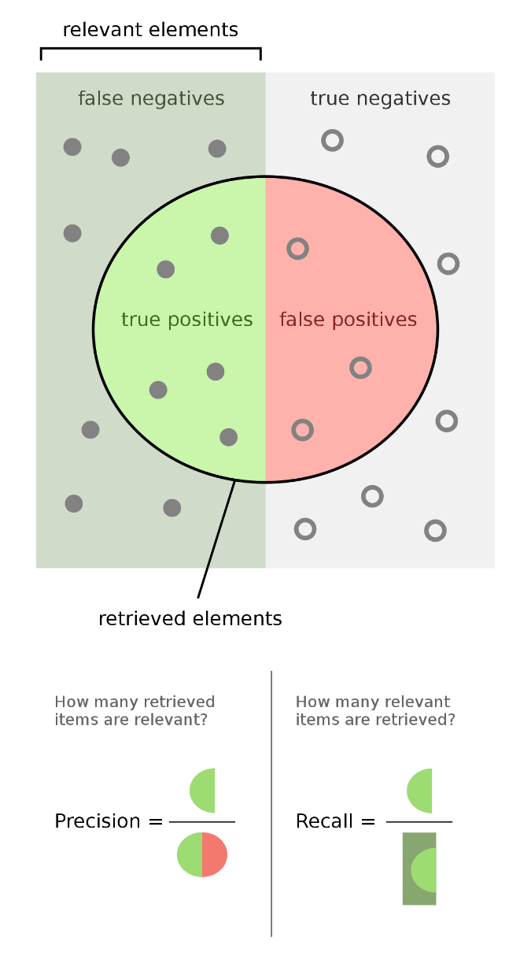

Evaluating Your Model
Recall and F1-Score
Recall
Recall tells us how many of the actual positive results were correctly identified by the model. It's like asking, "Of all the spam emails, how many did the model catch?“
If there were 60 spam emails in total and the model correctly identified 50 of them, the recall is 50/60 ≈ 83%
Recall is crucial when you want to catch as many positive instances as possible, even if it means getting some false positives.
High recall means that the model is good at finding all the positives, even if it sometimes gets it wrong.
F1-Score
The F1-score is a balance between precision and recall. It gives us a single number that represents the model's accuracy in catching positive results while avoiding false positives.
Think of it like an overall score for the model’s performance in terms of finding spam emails accurately and avoiding false alarms.
Figure shows visual representation of Precision and Recall.

Slide 11

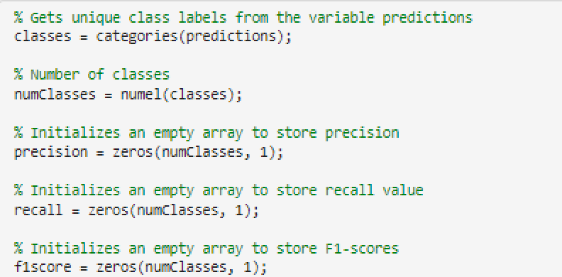
Evaluating Your Model
Precision, Recall, and F1-Score Code Example
Now let’s put precision, recall, and f1-score together in one example of code. First let’s make variables to store these metrics.
Creates a categorical array.
Initializing arrays to calculate the following parameters: precision, recall, and F1 Score.`
Variable holds number of classes.

Slide 12

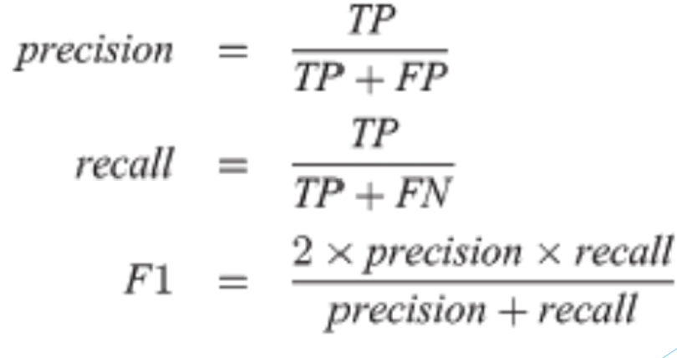
Evaluating Your Model
Extracting Important Parameters
Using the for loop below we can step through the confusion matrix to extract the values necessary to calculate the precision, recall, and F1-score.
The equations below are used in the code to calculate precision, recall, and F1-score. These equations use true positive (TP), false positive (FP), and false negatives (FN) values extracted from the confusion matrix.

Slide 13
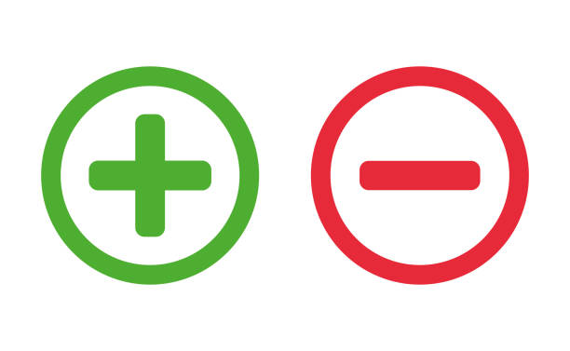
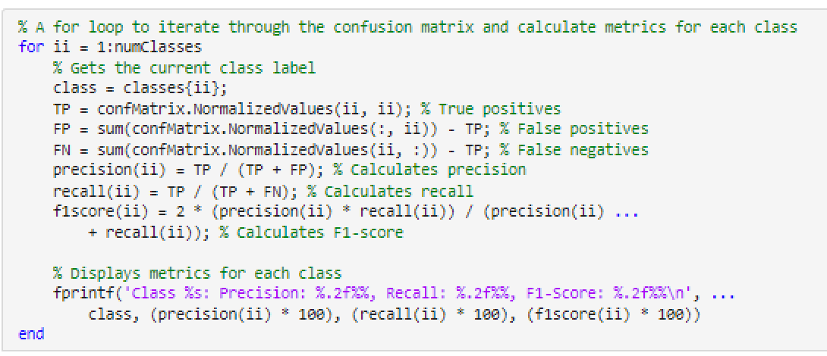

Evaluating Your Model
Calculating Positives and Negatives
For loop is created to iterate through the matrix to calculate the parameters we discussed previously.
True Positive calculation.
False Positive calculation.
False Negative calculation.
Precision calculation.
Recall calculation.
This line prints out the calculated Precision, Recall, and F1-Score for the current class in a formatted way.
F1-Score calculation.
Expected Output:
Output shows the precision, recall, and F1-Score for all 3 classes!

Slide 14

Evaluating Your Model
Calculating Positives and Negatives
Below we calculate the total number of true positives, and false negatives. These metrics are essential for evaluating the performance of the classification model.
True Positives are found by adding all values in the diagonal of the confusion matrix.
False Positives are found by adding the number of instances incorrectly predicted as positive.
False Negatives are found by adding the number of instances incorrectly predicted as negative.

Slide 15

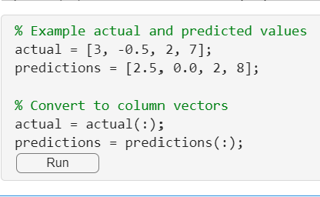
Evaluating Your Model
Regression Models
For regression tasks, evaluating the model's performance involves using different metrics compared to classification tasks. The most common metrics used for regression model evaluation are Mean Absolute Error (MAE), Mean Squared Error (MSE), and R-squared (R²). Let's create more example prediction and actual values.
Array creation to compare predictions vs actual values. This is to use how effective our model is.
Code used to convert row vectors to column vectors.

Slide 16


Evaluating Your Model
Mean Absolute Error (MAE)
MAE is the average of the absolute differences between the predicted values and the actual values.
It provides a measure of how close the predictions are to the actual outcomes.
Formula to calculate MAE (Mean Absolute Error) in MATLAB Syntax.

Slide 17

Evaluating Your Model
Interpreting MAE
The interpretation of a "good" or "bad" MAE depends on the context of the problem and the scale of the data.
Examples of varying contexts:
For predicting house prices, an MAE of $10,000 might be acceptable given the high value of the houses.
However, in predicting the temperature, an MAE of 10 degrees might be considered very poor.
Examples of varying scales:
If you're predicting values that typically range from 1 to 100, an MAE of 1 might be quite good.
If the values range from 1,000 to 10,000, an MAE of 1 might be excellent.

Slide 18

Evaluating Your Model
Mean Squared Error (MSE)
MSE is the average of the squared differences between the predicted values and the actual values.
It emphasizes larger errors more than MAE because errors are squared.
Formula to calculate MSE (Mean Squared Error) in MATLAB Syntax.

Slide 19

Evaluating Your Model
Interpreting MSE
Interpreting whether an MSE is "good" or "bad" depends on the context of the problem, similar to MAE, but with additional emphasis on larger errors due to the squaring:
Context and Domain:
In domains where precision is crucial, a smaller MSE is desired.
The impact of the squared error means that larger errors are penalized more heavily, making MSE sensitive to outliers.
Scale of the Data:
The absolute values of the data significantly impact the interpretation of MSE.
For data with a large range, MSE tends to be larger, while for data with a smaller range, it should be smaller.

Slide 20

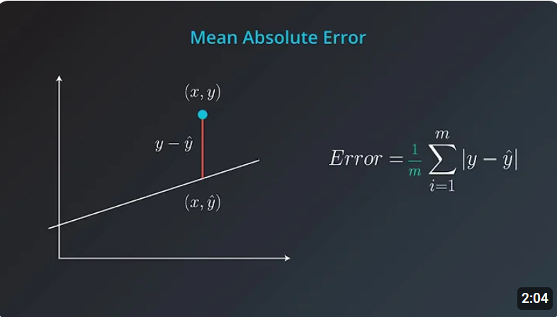
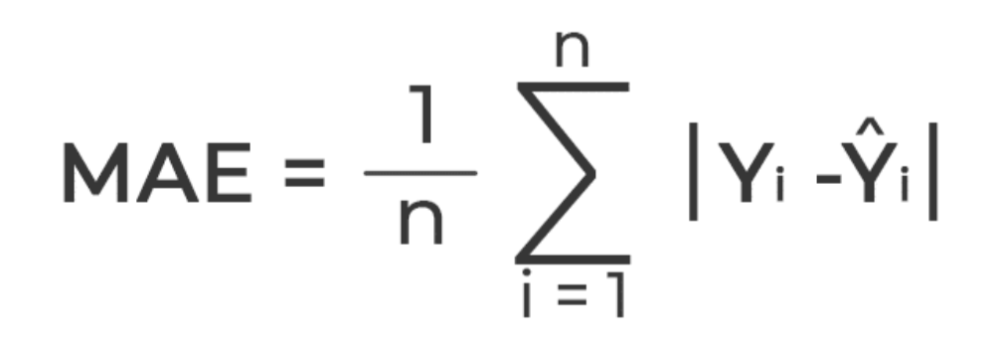
Evaluating Your Model
Example with both MAE and MSE
Predicting House Prices
Suppose the actual house prices range from $100,000 to $500,000.
An MAE of $5,000 might be considered quite good because it represents a small percentage of the total price range (around 1-5%).
An MSE of $250,000,000 (e.g., if the errors are around $500 each squared) might be considered good in this context because it indicates relatively small average errors
Figure shows MAE formula
Video on MAE: Link

Slide 21
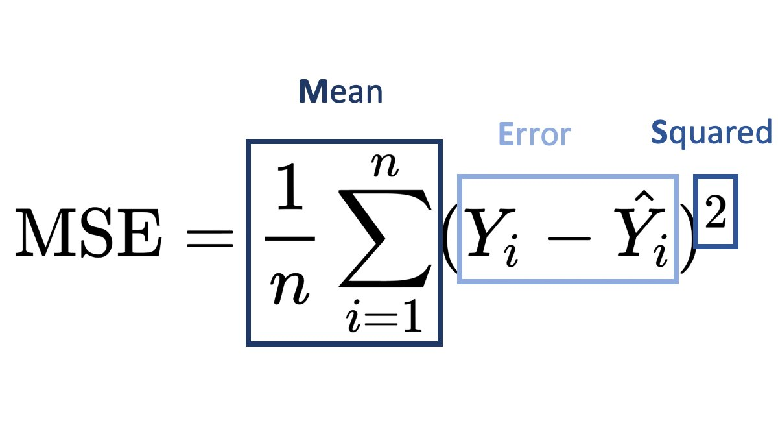
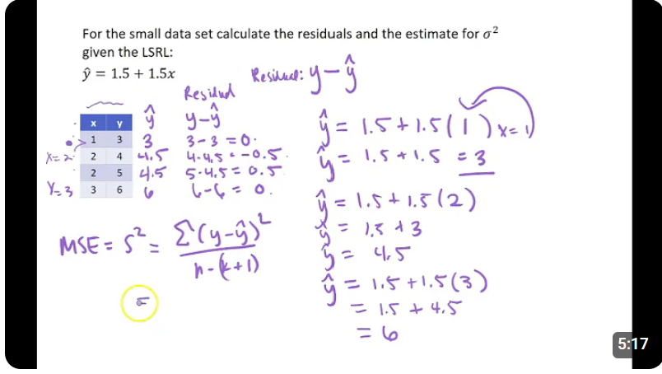
Evaluating Your Model
Example with both MAE and MSE
Predicting Daily Temperature
Suppose the actual temperatures range from 0 to 40 degrees Celsius.
An MAE of 2 degrees might be acceptable, while an MAE of 10 degrees would be considered poor since it indicates significant deviations from the actual values.
An MSE of 25 (e.g., if the errors are around 5 degrees each squared) would be considered poor, indicating significant deviations from the actual values.
Figure shows MSE formula
Video on MSE: Link

Slide 22
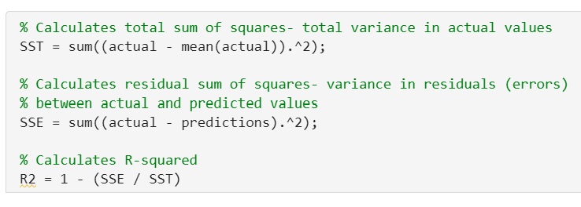
Evaluating Your Model
R-squared
R², also known as the coefficient of determination, indicates how well the regression predictions approximate the real data points.
An R² of 1 indicates that the regression predictions perfectly fit the data.
Must calculate both total sum of squares and residual sum of squares!
Formula shows the calculation of R^2, also known as the correlation coefficient!

Slide 23
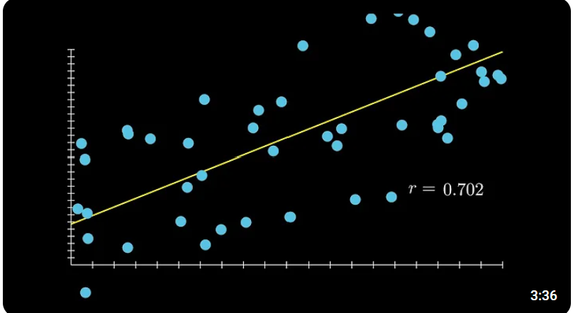

Evaluating Your Model
Interpretation of R-Squared Values
R² has a range of 0 to 1. While an R² of 1 indicates a perfect fit, an R² of 0 indicated a very poor fit. Furthermore, when deciding if the R² is acceptable, it depends on the context:
High R²: Generally, indicates a model that fits the data well. However, an excessively high R² (close to 1) could also indicate overfitting, especially if the model has a large number of predictors.
Low R²: Indicates that the model does not explain much of the variance in the dependent variable. However, what constitutes a "low" R² can depend on the context and the field of study. For instance, in social sciences an R² value around 0.3 might be considered acceptable while in physical sciences, an R² value below 0.9 might be considered poor.
Video on correlation coefficient: Link

Slide 24
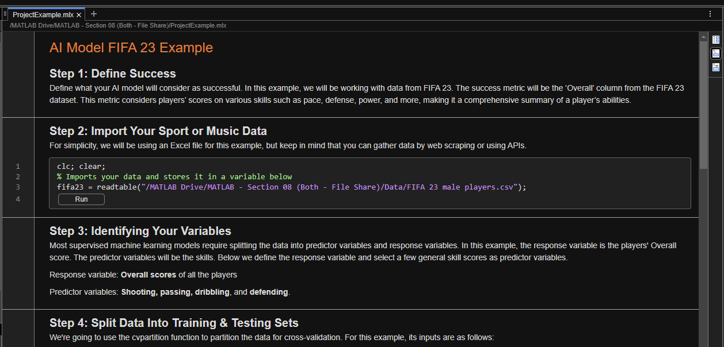
Final Project – Evaluating and Refining Your Model – Example AI Tool
Please copy over the files for Section 08 from the MATLAB Drive.
The MATLAB files for this section can be found at this link.
Notes:
The URL on this slide is for the student version of the files, please see the teacher guide for the teacher version of the files You can also find the teacher and student links on the master document with all the youtube video and matlab drive links for every section on it

Slide 25

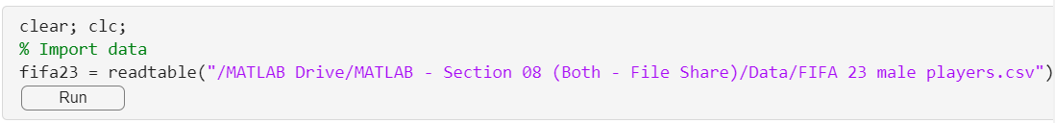
Evaluating Your Model
Step 2: Import Data
Continuing the FIFA 23 Example
Let’s use the code from Section 7 so we can continue our FIFA example. In the code block below, we will quickly go through the steps introduced in Section 7 and introduce two new steps. Steps 1, 3, and 5 do not require coding, so they do not appear in the following slides.
To import data into our MATLAB, we must use the readtable().

Slide 26
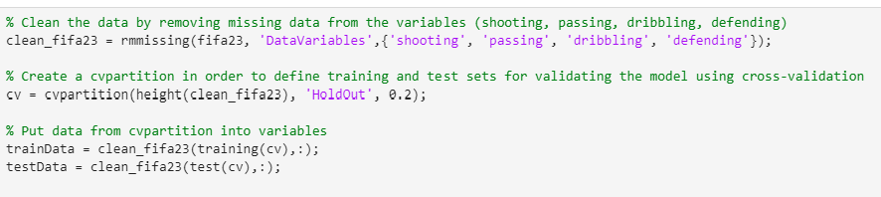
Evaluating Your Model
Step 4: Splitting Data into Training and Testing Sets
Function used to clean data by removing missing information.
This creates two datasets: one for training the model and the other for validating the model.
Saves cleaned data into the two variables: trainData and testData.

Slide 27

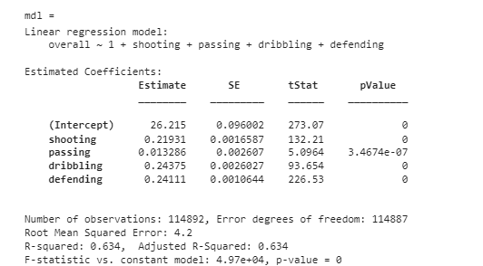
Evaluating Your Model
Step 6: Fitting a Model to Your Data
Expected Output:
This function used to fit a based on certain variables/characteristics.
Test statistics calculated from data involving defending, dribbling, passing, and shooting.
More information calculated from the fitted model: including number of observations, degrees of freedom, and R-squared.

Slide 28
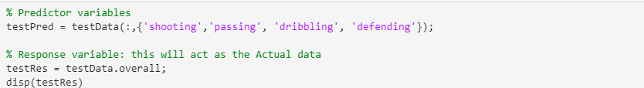
Evaluating Your Model
Step 7: Run Model Using Your Test Dataset
Now, let's create our response and predictor variables from the testData made using the cvpartition function. Recall that cvpartition sets aside a portion of the overall dataset to use for testing later on. Because we already know what the response variables are, this is an example of a supervised machine learning model.
This variable holds our predictor variables.
This variable will hold the actual, true data.

Slide 29
Evaluating Your Model
Step 7: Run Model Using Your Test Dataset
Now that we've fit the model to the data and made our testing data, it's time to make predictions using the predict function.
Assign the predictions to a variable.
The predict function uses two inputs:
The first is the model you trained
The second input is the predictor variables
The output will be the predicted response variables
This variable will create predictions based on the trained model from the test dataset.

Slide 30



Evaluating Your Model
Step 8: Evaluate the Model
Evaluate the model using the metrics introduced earlier in this section.
This code block calculates mean absolute error.
This code block calculates mean squared error.
This code block calculates R-Squared.

Slide 31

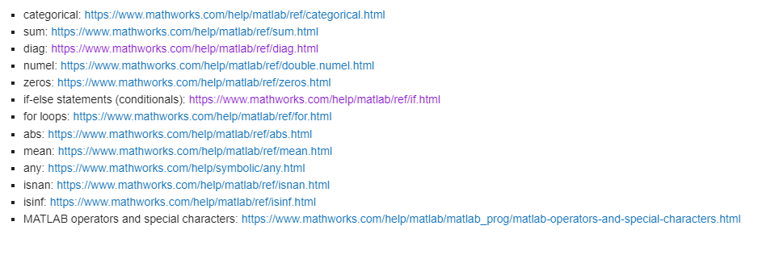
Evaluating Your Model
Refining your Model and MATLAB Documentation
After evaluating your model, you may have some undesirable metrics. You might have a low accuracy, an R-squared of 1, etc. There is no one way to fix issues like those, so the best way to start would be by reexamining your data and the model used. The model you may have picked might not be the best fit for your data. Use the documents and lessons provided to you as a resource and remember that every project will be specific to you.
Some of the functions in the above code may seem unfamiliar or you may want to jog your memory on them. Recall the help function demonstrated in lesson 7. Here are also some links to MATLAB documentation if you want to learn more (Located in the live script from section 08).
Figure shows links of some of the MATLAB documentation located in section 08.

